Slide 1
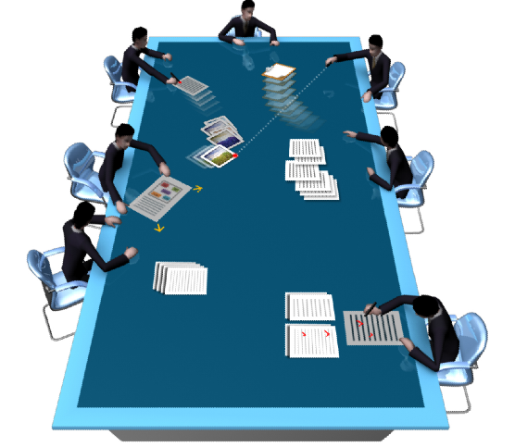
uTable: A Large Scale Interactive Tabletop System
秦永强 （Yongqiang Qin）
FIT 415 @ Tsinghua
Key Lab. of Pervasive Computing, Tsinghua University, China
Notes:
Introduce part of our research on tabletop computing

Slide 2
Outlines
Introduction
Hardware
Multi-Touch Input Recognition
Software
Notes:
Today my talk will devided into 4 parts. First is a brief introduction to uTable

Slide 3
Outlines
Introduction
Hardware
Multi-Touch Input Recognition
Software
Notes:
Today my talk will devided into 4 parts. First is a brief introduction to uTable

Slide 4
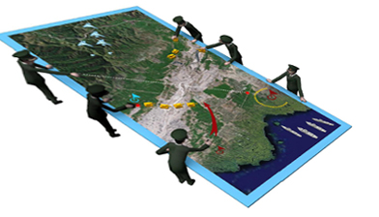
Introduction
uTable is short for “ubiquitous Table”
Display size : 3.84m x 2m
Resolution: 3810 x 2048
It’s LARGE, but NOT only large.

Slide 5
Introduction
What can it do?
Natural Interaction : direct manipulation
Multi-User, Multi-Modal Interaction
Co-Located Discussion on Tabletop
As well as the functions of the real physical table.
It’s LARGE, but NOT only large.
Notes:
As a table, it also preserve the functions of the real physical table
Okay, It’s large, but not only large

Slide 6
Introduction
Challenges
Large Scale VS. Table Height
Height ≤ 800 mm (according to Human Factors Engineering)
Large Scale VS. Unity of Display
The “Sun Effects”
The uniformity of brightness
Visual Output VS. Interactive Input
The better visual output is, the worse interactive input is.
Large Scale VS. Precise Input
Suitable input method : DI ? FTIR ? …
Different UI management policy
Notes:
There are many contradictions
The display surface is also the input surface
Additionally, the ui management policy is different, from desktops, small tabletops, such as surface and SMART table.

Slide 7
Outlines
Introduction
Hardware
Multi-Touch Input Recognition
Software
Notes:
To solve the problems above and find a tradeoff between those parameters, we make great efforts on the hardware design.

Slide 8
Hardware
Architecture
Visual Output apparatus
Multi-Touch Input apparatus
Pen liked Device
Notes:
The hardware design can also be divided into four parts

Slide 9
Hardware
Architecture
Visual Output apparatus
Multi-Touch Input apparatus
Pen liked Device
Notes:
The hardware design can also devided into four parts, Let’s see the architecture first

Slide 10
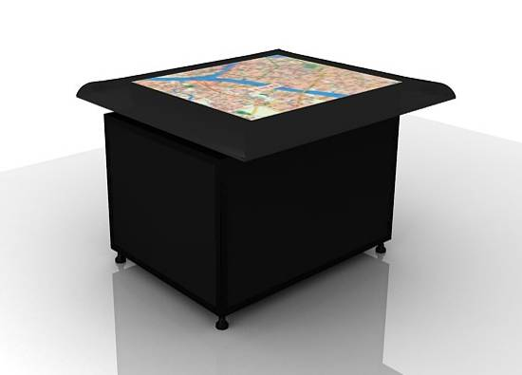
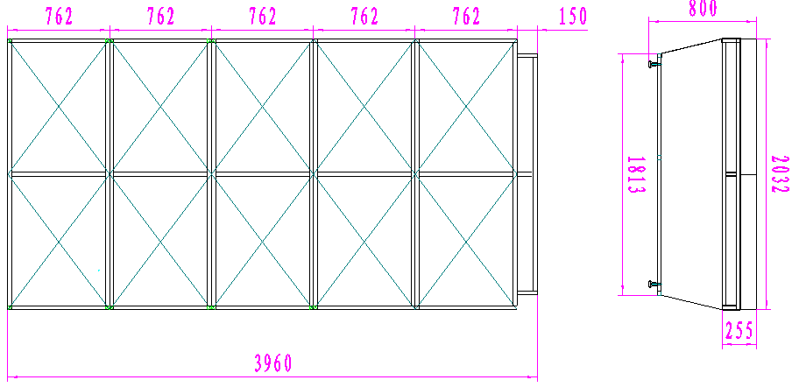
Hardware—Architecture
Split joint architecture
Each sub unit is a complete tabletop device
Has its own output and input apparatus
Multiple sub units join together into the entire uTable.
Seamless joint (the seam is less than 0.5mm)
Join
Together
Notes:
The uTable consists of many sub units, and each sub unit is a complete tabletop device, means that each unit has its own output and input apparatus [ˌæpəˈreitəs]. Multiple sub units join together into the entire uTable, and the seam is less than 0.5 millimeter
This figure shows the split joint architecture, 10 sub units buildup the uTable.

Slide 11
Hardware
Architecture
Visual Output apparatus
Multi-Touch Input apparatus
Pen liked Device
Notes:
The following is output

Slide 12
Hardware—Output
Display Device
Industrial Projector, rear projection
Display layer:
4 parts : bearing glass, Fresnel Lens, Rear-Projection Film and the front protection glass.
Notes:
To obtain uniform chroma ['krəumə] and brightness of the entire uTable, we choose industrial projector as the display device, and rear projection manner
As to the display layer, it was made up of four parts: bearing glass below,and Fresnel [frei'nel] lens following, and then the rear projection film and the front protection glass. The film has a wide view angle, which is about 120 degrees

Slide 13
Hardware
Architecture
Visual Output apparatus
Multi-Touch Input apparatus
Pen liked Device
Notes:
An apparatus for multi-touch input is required in such interactive table, let have a glance on it.

Slide 14
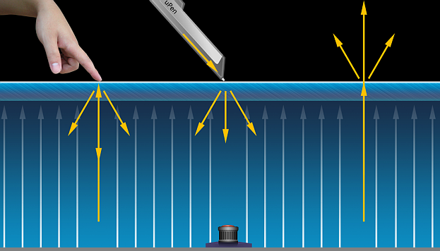
Hardware—Input
DI (Diffuse Illumination), which is
Safe to users’ eyes.
No blind areas of the surface
No physical borders of each sub-apparatus
Rich raw data for computer vision algorithm.
Notes:
There are many methods for input signal capture, and we finally choose DI(diffuse illumination) which is safe to user’s eyes and no theoretical blind areas of the surface, most importantly, DI method can meet the seamless joint of the sub units. And also, there are rich raw data to the recognition system based on computer vision technology

Slide 15
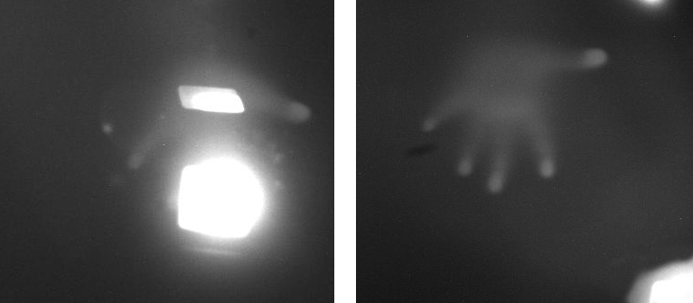
Hardware—Input
blind areas of the camera view

Slide 16
Hardware—Input
Multi-camera in one sub unit
Eliminate blind areas of the surface
Precision of the input
Synchronously working under control
Multi-camera in each unit
Synchronization
Notes:
To obtain precise input and eliminate blind areas of the surface, there are multiple cameras below the tabletop surface, and they are running synchronously ['siŋkrənəsli] under a control center.
Unfortantely, the hardware entire uTable is still under manufacturing in the factory, so we cannot show it at this time.

Slide 17
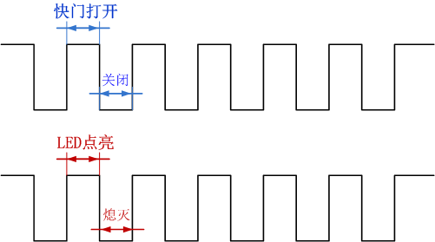
Hardware—Input
Cameras & IR Lights Synchronization

Slide 18
Hardware
Architecture
Visual Output apparatus
Multi-Touch Input apparatus
Pen liked Device
Notes:
To enable pen based interaction on uTable, we develop a pen liked device called uPen

Slide 19
Hardware—Pen-Liked-Device
Similar to uTable, we named it as uPen
Pressure sensitive on vision based tabletop surfaces
Device identification based on RFID
Remote interaction possibilities.
Notes:
To enable pen based interaction on uTable, we develop a pen liked device called uPen
uPen is pressure sensitve on vision based tabletop surfaces and we can easily identify each pen with the help of RFID
It also have remote interaction possibilities since there is a laser emitter.

Slide 20
Outlines
Introduction
Hardware
Multi-Touch Input Recognition
Software
Notes:
Based on the hardware, multi-touch input recognition algorithm is required to recognize interactive inputs.

Slide 21
Multi-Touch Input Recognition
Sub unit recognition
Computer Vision methods
Based on CCV (Community Core Vision)
Multiple input channels fusion
Multiple cameras in the same sub unit
Multiple inputs from sub units
uPen messages
Notes:
The algorithm is based on a popular open source project CCV (Community Core Vision) recognizing separate inputs and a later input fusion module which fuse the multiple interactive inputs as well as uPen messages together.

Slide 22
Recognition—Single unit
Based on CCV
TUIO messages
Enhanced recognition algorithm
Enhanced tracking algorithm
Notes:
We made some improvements on CCV: hysteretic binarization and using adaptive thresholds in different areas.

Slide 23
Recognition—Single unit
Finger Detecting Descriptors
r= 6 Circle & R=9 r = 6 Ring
Finger : Circle – Ring > Threshold

Slide 24
Recognition—Fusion
CCV
Noise
Drop
……
Fusion
Kalman Filter
Filter
App
CCV
Noise
Drop
Filter
Fusion
……
…
CCV
Noise
Drop
App
……
Fusion
Kalman Filter
Filter
CCV
Noise
Drop
uPen
Notes:
This the fusion flow chart, we used two level fusion blocks, a lower level fusion block for separate sub units and a higher level fusion block for the entire uTable inputs.

Slide 25
Recognition—Gesture Engine
Translate the touch spots into commands
Touch spots
Locus Group
Gesture
Locus
Command
Notes:
A gesture engine is also needed to translate the recognized touch spots into commands, which is understandable by the upper software.

Slide 26
Outlines
Introduction
Hardware
Multi-Touch Input Recognition
Software
Notes:
Okay, after the bottom layer of uTable, let’s have a look at the software based on uTable.

Slide 27
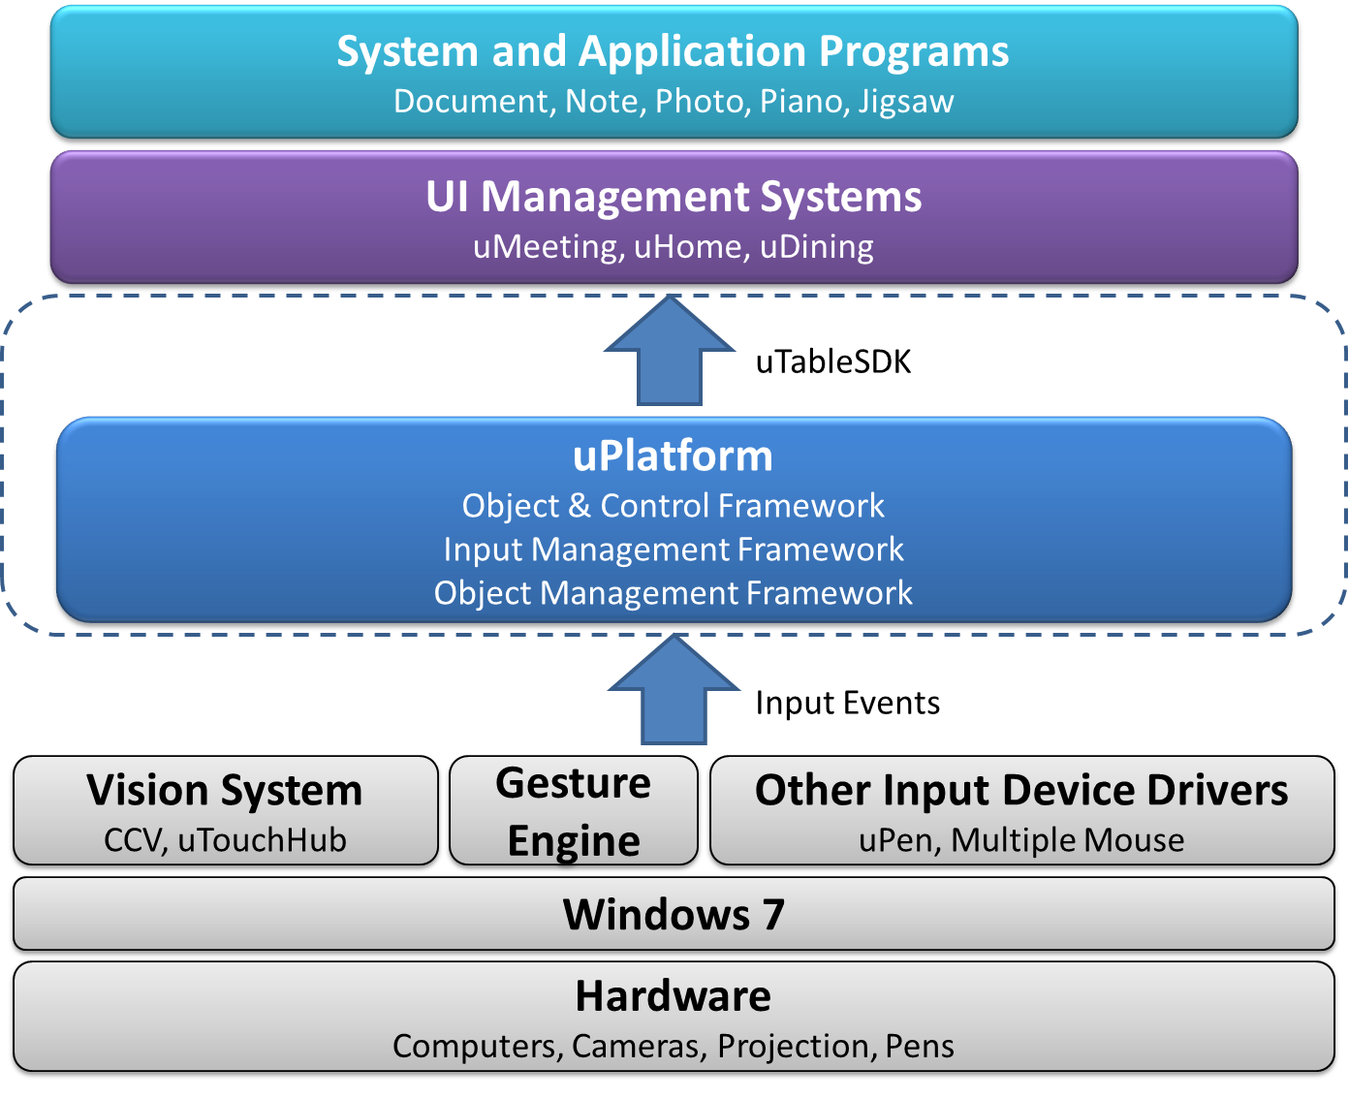
Software—Architecture
Notes:
The architecture is shown as this figure. All the software is running on windows 7.
And based on the hardware and recognition sub system, we established uPlatform, a framework for digital object control and input management, and then based on the uTableSDK, developers can develop many applications on uTable. And also, the interface between user input level and UI systems are TUIO, so those applications can also run on other TUIO tabletop systems

Slide 28
Software
Gesture Engine
uPlatform
uTableSDK
Applications

Slide 29
Software—uPlatform
Notes:
This is the uPlatform architecture, it has three levels: input manager, object manager and object tree.
The input manager manage multi-user’s multi-modal inputs and translates the input commands to object manager, after an input interpretation and conflict elimination, the input command will be executed and the UI will also be updated.

Slide 30
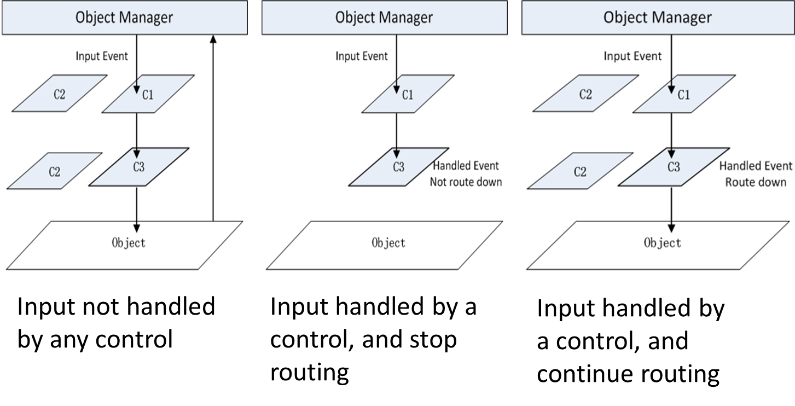
Software—uPlatform
Input Routes
Notes:
This figure shows the input routes in the object tree, a command will be handled by a right object and continue routing until a object prevent it from routing in the object tree. If no objects can handle the input, it will be returned back to the object manger.

Slide 31
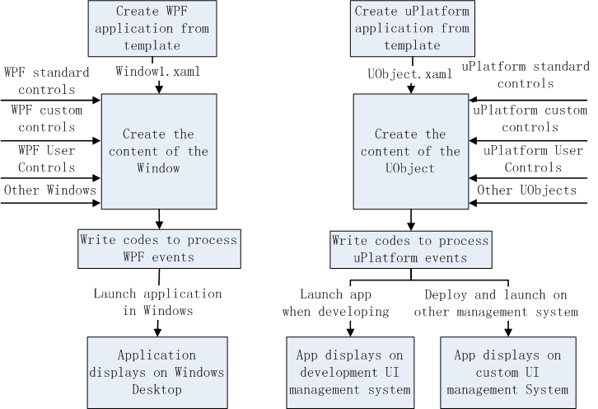
Software—uTableDK
Similar to create a WPF application.
Notes:
We also publish our uTableSDK for developers conveniently create uPlatform Applications on uTable, it’s easy to do this for its’ similar to create a WPF application.

Slide 32
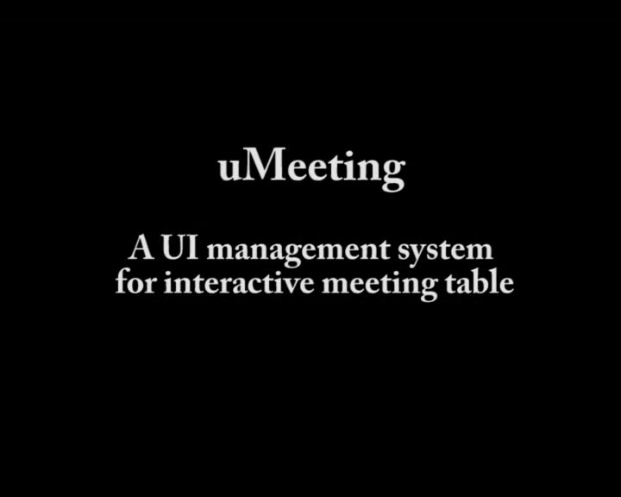
Software—Applications
Notes:
Now here are some applications based on the uTableSDK.
This is uMeeting, User can fetch a book from his digital drawer, make annotations and sharing with others.
Based on uPlatform, users can create different working spaces, for collobrative working, and personal work.
Here is a different application: jigsaw
In uDinning, we can order our favourate dish by direct-manipulation on the digital menu.

Slide 33
Thank you!
Pervasive Computing Group @ 3-526, FIT
http://pi.cs.tsinghua.edu.cn
Notes:
That’s it. And welcome to our lab for detailed discussion.

